Slide 1



http://pingo.edu.vn/khoa-hoc-php-can-ban/
PHP Basics - Strings
Web Applications in Hatch
Tuan Duong
http://pingo.edu.vn/tuan-duong/

Slide 2
Contents
“A string is series of characters, where a character is the same as a byte.”
“ This means that PHP only supports a 256-character set, and hence does not offer native Unicode support.”

Slide 3
String types
single quoted
$str = ‘this is a string’
double quoted
$str = “this is a string”
heredoc syntax
$str = <<<EOD Example of string spanning multiple lines using heredoc syntax. EOD;
nowdoc syntax (since PHP 5.3.0)
$str = <<<'EOD‘ -> enclosed by ‘…’ Example of string spanning multiple lines using nowdoc syntax. EOD;

Slide 4
Single quoted
Note: Unlike the double-quoted and heredoc syntaxes, variables and escape sequences for special characters will not be expanded when they occur in single quoted strings.
Example | Output | Description
echo 'this is a simple string'; | this is a simple string
echo 'You can also have embedded newlines in strings this way as it is okay to do'; | You can also have embedded newlines in strings this way as it is okay to do | newline could embedded in strings
echo 'Arnold once said: "I\'ll be back"'; | Arnold once said: “I'll be back | ‘ was escape by \’
echo 'You deleted C:\\*.*?'; | You deleted C:\*.*? | \ was escaped by \\
echo 'You deleted C:\$*.*?'; | You deleted C:\$*.*? | \$ is kept as it is
echo 'This will not expand: \n a newline'; | This will not expand: \n a newline | \n(newline) is kept as it is.
echo 'Variables do not $expand $either'; | Variables do not $expand $either | variable is not expanded

Slide 5
Double quoted
PHP will interpret more escape sequences & variables for special characters:
Sequence | Meaning
\n | new line
\r | carriage return (CR), it means return to beginning of line
\t | tab (or horizontal tab)
\v | vertical tab (since PHP 5.2.5)
\e | escape (ESC in ASCII) (since PHP 5.4.0)
\f | form feed (since PHP 5.2.5)
\\ | backslash
\$ | dollar sign
\" | double-quote
\[0-7]{1,3} | the sequence of characters matching the regular expression is a character in octal notation
\x[0-9A-Fa-f]{1,2} | the sequence of characters matching the regular expression is a character in hexadecimal notation

Slide 6
Variables in strings
Double quoted strings offer something more:
Variables in double-quoted strings are evaluated
Note on arrays:
$saying = "I'll be back!";
$str1 = "Arnold once said: $saying";
// this will output:
// Arnold once said: I'll be back!
$sayings = array ('arni' => "I'll be back!");
$str1 = "Arnold once said: ${sayings['arni']}";

Slide 7
Heredoc syntax
Define strings with heredoc syntax ('<<<')
After the <<< we put "ending delimiter" – string goes all the way to this delimiter
The delimiter must be followed by new line
The ending delimiter must be alone on the last line, starting from first column
Same escaping behavior as double-quoted string
In single and double quoted strings you can embed new lines too
$str = <<<EOT
This Is the string content
EOT;

Slide 8
Heredoc
Heredoc use <<< IDENTIFIER to start & stop at IDENTIFIER at 1st column.
It works as same as double quote string so that variables & escape sequences will be interpreted.
Identifier
Variable is interpreted
echo <<<EOT My name is "$name". I am printing some $foo->foo. Now, I am printing some {$foo->bar[1]}. This should print a capital 'A': \x41 EOT;
“ or ‘ does not need an escape
Must be 1st column

Slide 9
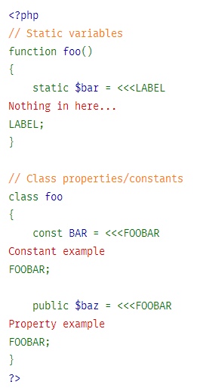
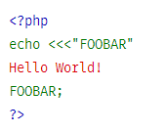
Heredoc
Use heredoc to initialize variables
Identifier at 1st column
This is an heredoc as well. Please be notice that identifier is coverred by double quote.
If it was cover by signal quote, it would be a Nowdoc

Slide 10
Nowdoc
Nowdoc is as same as Heredoc, but has a signal quote for identifier.
NO PARSING is done inside Nowdoc
single quote identifier
Variable is NOT interpreted
echo <<<‘EOT’ My name is "$name". I am printing some $foo->foo. Now, I am printing some {$foo->bar[1]}. This should print a capital 'A': \x41 EOT;
“ or ‘ does not need an escape
Must be 1st column

Slide 11
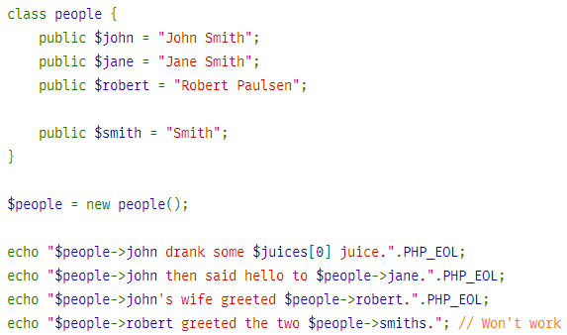
Variable parsing
$juices = array("apple", "orange", "koolaid1" => "purple"); echo "He drank some $juices[0] juice.".PHP_EOL; echo "He drank some $juices[1] juice.".PHP_EOL; echo "He drank some $juices[koolaid1] juice.".PHP_EOL;
We use “.” to concatinate strings
$people->smith (not $people->smiths)

Slide 12
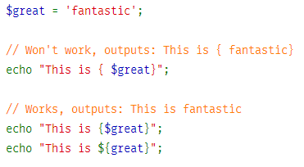
Variable parsing (curly)
We can enclose variable by {$var} in a string. There should be NO SPACE between {} & variable
There is a space

Slide 13
String access
String could be used as array of characters. First character is at ZERO.
$str = 'This is a test.'; $first = $str[0]; → “T” $last = $str[strlen($str)-1]; → string length
$str[strlen($str)-1] = 'e'; → modify last char

Slide 14
Useful functions and operators
Strings may be concatenated using the '.' (dot) operator. Note that the '+' (addition) operator will not work for this.
Function | Example | Description
strval() | strval($str) | convert variable to string Boolean TRUE will be “1” Boolean FALSE will be “” (empty) NULL will be “” (empty)
 | $foo = 1 + "10.5"; $foo = 1 + "-1.3e3"; | $foo is float, because we has “.” in string $foo is integer, -1299
 | $foo = 1 + "bob3"; | $foo is integer, because string could NOT be converted
 | $foo = 1 + "10 Small Pigs"; | $foo is 11, “Small Pigs” was skipped
strlen() | strlen($str) | string length
var_dump | var_dump($str) | print out a string
print_r | print_r(str) | print out a string

Slide 15
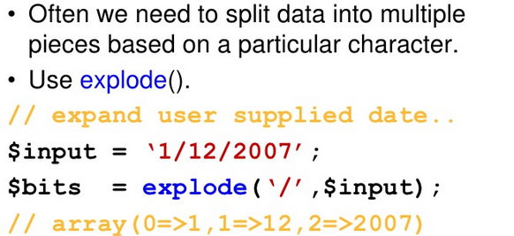
Useful functions: splitting

Slide 16

Useful functions: trimming

Slide 17
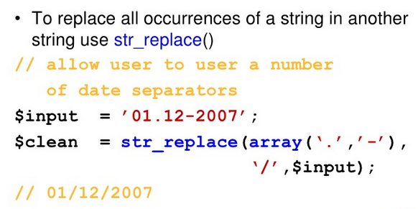
Useful functions: string replace

Slide 18
Useful functions: cAsE
To make a string all uppercase use strtoupper().
To make a string all lowercase use strtolower().
To make just the first letter upper case use ucfirst().
To make the first letter of each word in a string uppercase use ucwords().

Slide 19
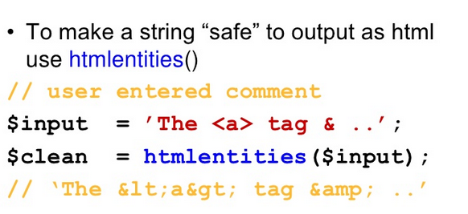
Useful function: html sanitise

Slide 20
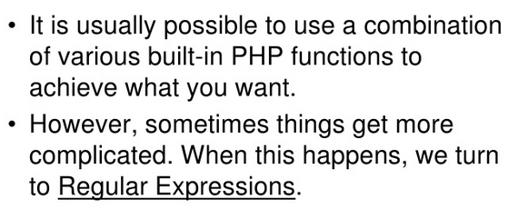
More complicated checks…

Slide 21
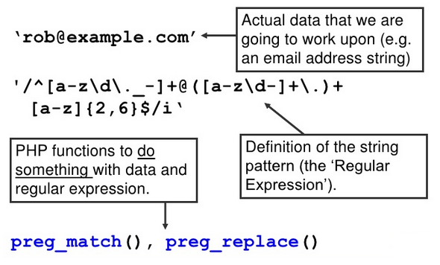
Some definitions

Slide 22
String & regular expression
PHP supports Perl-compatible regular expression functions
PERL is a programming language that super powerful in regular expression. Understanding this regular expression of Perl, we could re-use the knowledge in many kinds of programing such as PHP, Ruby,…

Slide 23
BRACKETS [ ]
Shows the range of search from the string
[0-9] any decimal digit from 0 through 9.
[a-z] from lowercase a through lowercase z.
[A-Z] from uppercase A through uppercase Z.
[A-Za-z] uppercase A through lowercase z.

Slide 24
Quantifiers
+ at least 1 character
* 0 or more characters
? any character
{1,2} occurrence 1 or twice
$ last character
^ first character or NOT(used in bracket)
Example in next slides

Slide 25
Quantifiers’ example
p+ matches any string containing at least one p.
p* matches any string containing zero or more p’s.
p? matches any string containing zero or one p.
p{2} matches any string containing a sequence of two p’s.
p{2,3} matches any string containing a sequence of two or three p’s.
p{2,} matches any string containing a sequence of at least two p’s.
p$ matches any string with p at the end of it.
^p matches any string with p at the beginning of it.
[^a-zA-Z] not containing ranging from a through z and A through Z.
p.p containing p, followed by any character, followed by another p.
^.{2}$ matches any string containing exactly two characters.
<b>(.*)</b> any string enclosed within <b> and </b>
p(hp)* p, followed by zero or more “hp”

Slide 26
Predefined Characters
Example | Output
[:alpha:] | [A-Za-z]
[:alnum:] | [A-Za-z0-9]
[:cntrl:] | Control characters such as a tab, escape, or backspace
[:digit:] | [0-9]
[:graph:] | ASCII 33 to 126
[:lower:] | [a-z]
[:punct:] | Punctuation chars ~ ` ! @ # $ % ^ & * ( ) - _ + = { } [ ] : ; ' < > , . ? and /.
[:upper:] | [A-Z]
[:space:] | Whitespace characters including the space, horizontal/vertical tab, new line, form feed, or carriage return
[:xdigit:] | Hexadecimal characters = [a-fA-F0-9]

Slide 27
Functions
Function | Description
ereg() | executes a case-sensitive search of string for pattern, returning TRUE if the pattern is found and FALSE otherwise.
eregi() | Unlike ereg(), the search is case insensitive
ereg_replace() | finding and replacing pattern, case sensitive.
eregi_replace() | finding and replacing pattern, case insensitive.
split() | divides string into various elements, with the boundaries of each element based on the occurrence of pattern in string
spliti() | similar as split, but case insensitive

Slide 28
Example
$username = "jasoN";
if (ereg("([^a-z])",$str)) …
if (!eregi("^[a-zA-Z0-9]{8,10}$", $str))
$text = "this is\tsome text that\nwe might like to parse.";
print_r(split("[\n\t]",$text));
Array ( [0] => this is [1] => some text that [2] => we might like to parse. )

Slide 29
Regular Expression Syntax (Perl Style)
Modifiers

Slide 30
Regular Expression Syntax (Perl Style)
Metacharacters
\A Matches only at the beginning of the string.
\b Matches a word boundary.
\B Matches anything but a word boundary.
\d Matches a digit character. This is the same as [0-9].
\D Matches a nondigit character.
\s Matches a whitespace character.
\S Matches a nonwhitespace character.
[] Encloses a character class (ex: [:digit])
() Encloses a character grouping or defines a back reference.
$ Matches the end of a line.
^ Matches the beginning of a line.
. Matches any character except for the newline.
\ Quotes the next metacharacter.
\w [a-zA-Z0-9_].
\W a string, omitting the underscore and alphanumeric characters.

Slide 31
Regular Expression Syntax (Perl Style)
Match funtions
Function | Return | Parameters | Description
preg_grep() | array | string pattern, array input [, flags] | The preg_grep() function searches all elements of the array input, returning an array consisting of all elements matching pattern. Consider an example that uses this function to search an array for foods beginning with p:
preg_match | int | string pattern, string string [, array matches] [, int flags [, int offset]] | The preg_match() function searches string for pattern, returning TRUE if it exists and FALSE otherwise. The optional input parameter pattern_array can contain various sections of the subpatterns contained in the search pattern, if applicable. Here’s an example that uses preg_match() to perform a case-sensitive search:
preg_match_all | int | string pattern, string string, array pattern_array [, int order] | The preg_match_all() function matches all occurrences of pattern in string, assigning each occurrence to array pattern_array in the order you specify via the optional input parameter order. The order parameter accepts two values:
preg_quote() | string | string str [, string delimiter] | The function preg_quote() inserts a backslash delimiter before every character of special significance to regular expression syntax. These special characters include: $ ^ * ( ) + = { } [ ] | \\ : < >. The optional parameter delimiter is used to specify what delimiter is used for the regular expression, causing it to also be escaped by a backslash.

Slide 32
Regular Expression Syntax (Perl Style)
Match funtions
Function | Return | Parameters | Description
preg_replace | mixed | mixed pattern, mixed replacement, mixed str [, int limit] | The preg_replace() function operates identically to ereg_replace(), except that it uses a Perlbased regular expression syntax, replacing all occurrences of pattern with replacement, and returning the modified result. The optional input parameter limit specifies how many matches should take place. Failing to set limit or setting it to -1 will result in the replacement of all occurrences.
preg_replace_callback | mixed | mixed pattern, callback callback, mixed str [, int limit] | Rather than handling the replacement procedure itself, reg_replace_callback() function delegates the string-replacement procedure to some other user-defined function. The pattern parameter determines what you’re looking for, while the str parameter defines the string you’re searching. The callback parameter defines the name of the function to be used for the replacement task. The optional parameter limit specifies how many matches should take place. Failing to set limit or setting it to -1 will result in the replacement of all occurrences. In the following example, a function named acronym() is passed into preg_replace_callback() and is used to insert the long form of various acronyms into the target string
preg_split | array | string pattern, string string [, int limit [, int flags] ] | The preg_split() function operates exactly like split(), except that pattern can also be defined in terms of a regular expression. If the optional input parameter limit is specified, only limit number of substrings are returned

Slide 33
Regular Expression Syntax (Perl Style)
Examples
$foods = array("pasta", "steak", "fish", "potatoes");
$food = preg_grep("/^p/", $foods);
This returns:
Array ( [0] => pasta,…, [3] => potatoes )
$line = "Vim is the greatest word processor ever created!";
if (preg_match("/\bVim\b/i", $line, $match))
print "Match found!“;
For instance, this script will confirm a match if the word Vim or vim is located, but not simplevim, vims, or evim.

Slide 34
Regular Expression Syntax (Perl Style)
Examples
$userinfo = "Name: <b>Zeev Suraski</b> <br> Title: <b>PHP Guru</b>";
preg_match_all ("/<b>(.*)<\/b>/U", $userinfo, $pat_array);
Note: U = stop at short match (ungreedy)
$pat_array will be
Array( [0] => “Zeev Suraski”, [1] => “PHP Guru”)
$text = "Tickets for the bout are going for $500.";
echo preg_quote($text);
This returns:
Tickets for the bout are going for \$500\.

Slide 35
PHP Basics - Strings

